Slide 1
SPROCKET CENTRAL PTY LTD
DATA ANALYTICS APPROACH
THE ANALYTICS TEAM

Slide 2
AGENDA
Relationship between data and features
Data Transformation
Reporting of key findings

Slide 3
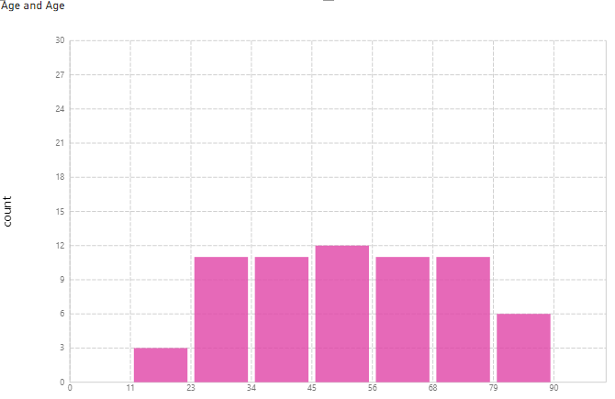
DATA EXPLORATION
New Customers by Age
New Customers are mostly from age range of 45-56

Slide 4
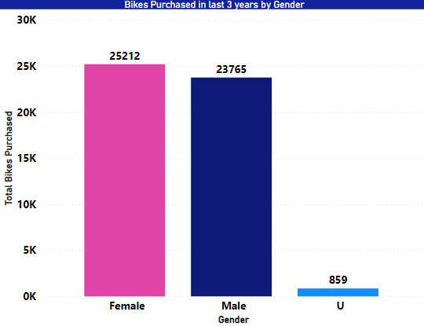
DATA EXPLORATION
TARGET??
Among New Customers, Females Purchased more bikes than male customers and we must market those audiences.

Slide 5
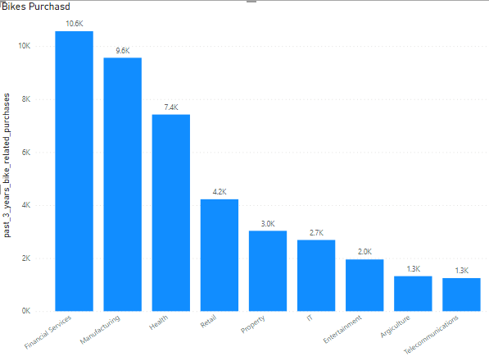
DATA EXPLORATION
Financial Sector, Manufacturing Sector and Health are top 3 sales as well as profit generating Industry

Slide 6
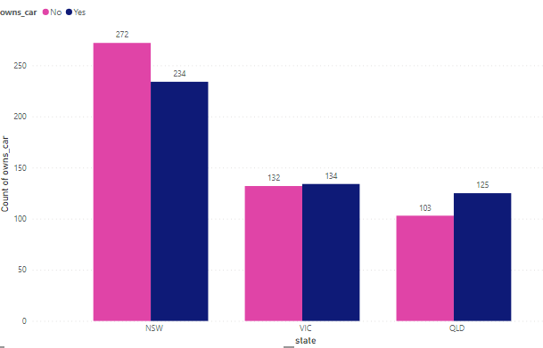
DATA EXPLORATION
TARGET??
People who own cars in NSW are more or less same as people who do not own.
We must target NSW as there is room for potential customers.

Slide 7
INTERPRETATION
TARGET CUSTOMERS FOR NEXT MODEL
Age Group | 45 to 60
Males or Females | Females
Target Industry | Health Finance Manufacturing
State | Mostly New South Wales

Slide 8
THANKYOU

